Slide 1
The Standing Rock Sioux Tribe’s Litigation AGAINST the Dakota Access Pipeline
Sylas Horowitz

Slide 2
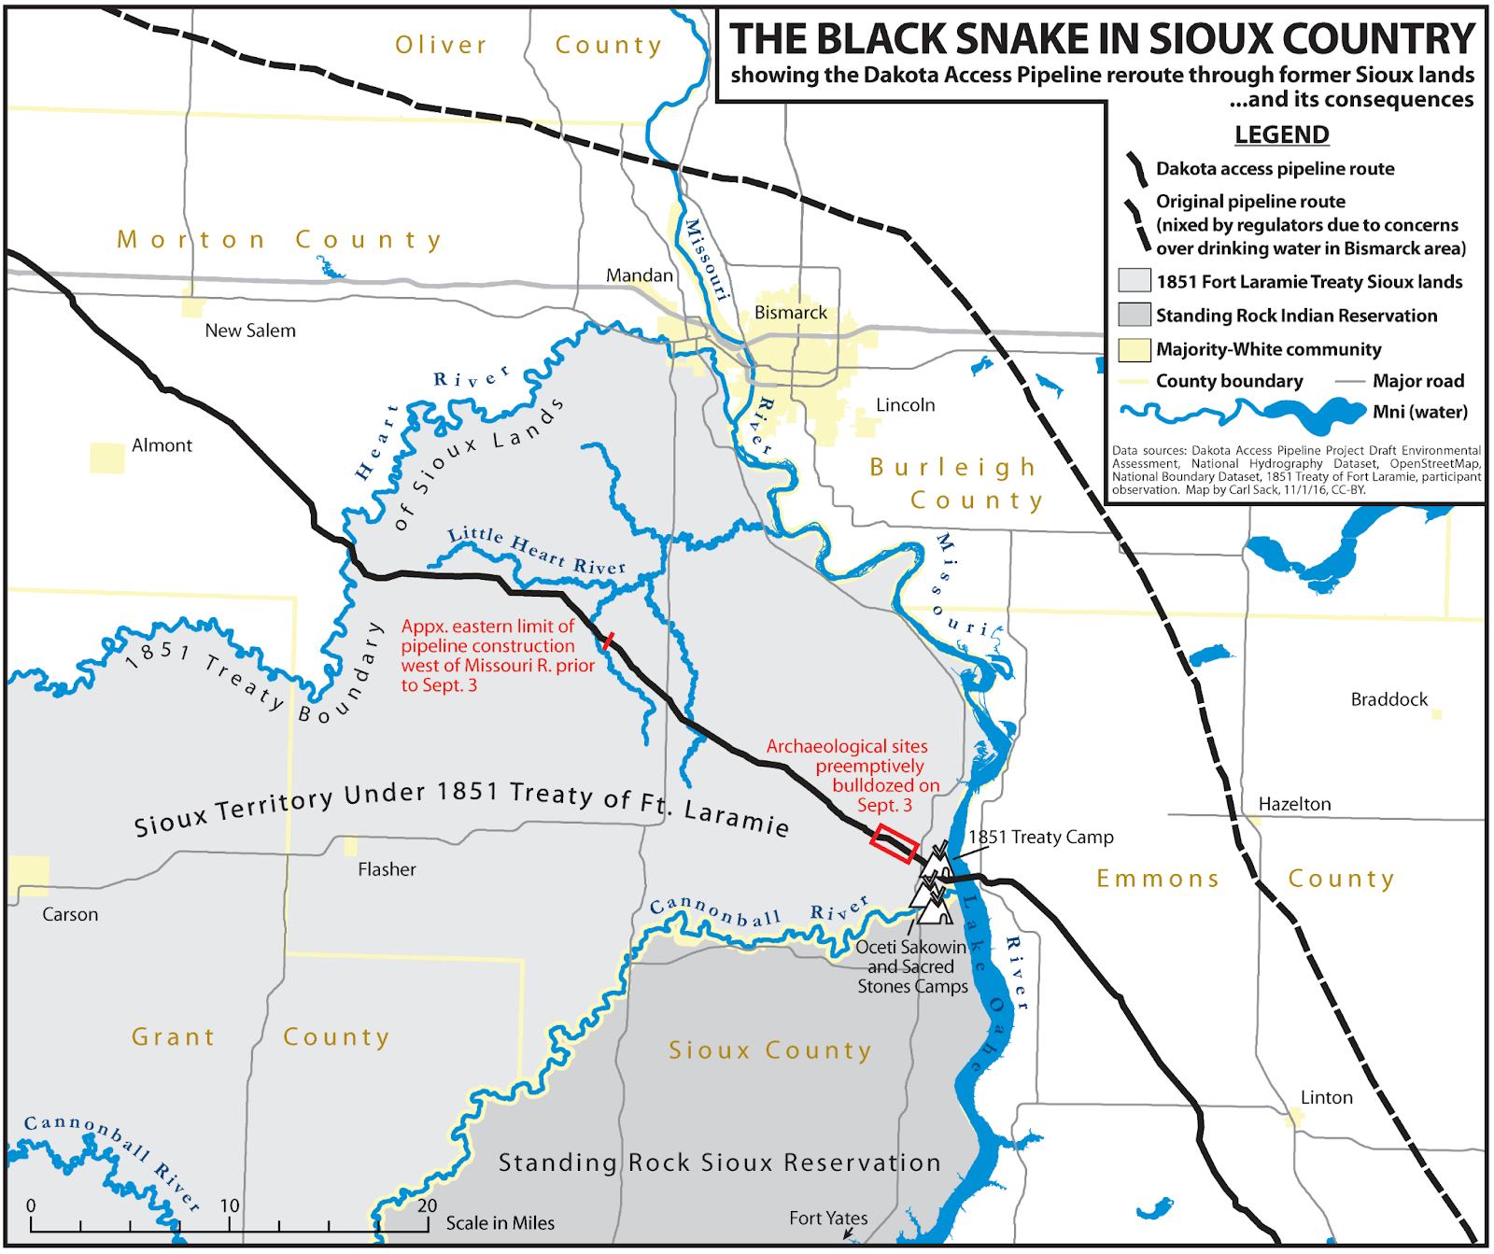
Dakota access pipeline (dapl)
1,172-mi, ND → IL
$3.78b, 570,000 bpd
Violates treaty rights
Threatens sacred prayer sites and ancestral burial grounds
Passes through 22 bodies of water
Missouri River and Lake Oahe – fishing grounds and primary water source

Slide 3
Series of events
January 2016
July 2016
August 2016
January 2017
February 2017
DAPL approved for construction via EA/FONSI
Standing Rock Sioux Tribe begins litigation against Corps
Thousands of water protectors protest from over 200 tribes, militarized police and Nat Guard injure 300 & face over $1,500 each in felony charges/bonds
Corps conduct site visit and decide to delay an easement for construction
Trump issues presidential memorandum to accelerate construction and operation, overriding EIS

Slide 4
Series of events
May 2017
June 2017
February 2019
March 2020
January 2021
DAPL began active
D.C. District Court finds federal permits for pipeline are illegal, remands Corps to address flaws
Corps find that EIS is not required
Court finds EIS required due to NEPA violations, orders temporary halt to operations in July
D.C. Circuit Court of Appeals affirms EIS, reverses halt to operations. DAPL is STILL operating today without a permit!

Slide 5
Influential factors
Treaty imaginary
Levels of legality
Permitting process
EXECUTIVE POWER
Court opinion
History of violations to tribal sovereignty invalidate treaty rights argument used by tribes
FPIC under UN international human rights law and protests
Western scientific materialim worldview in NEPA, flawed consultations and data
Changes EJ considerations in NEPA and permitting/operation decisions
Abides by NEPA guidelines and court precedents, often do not favor tribal rights

Slide 6
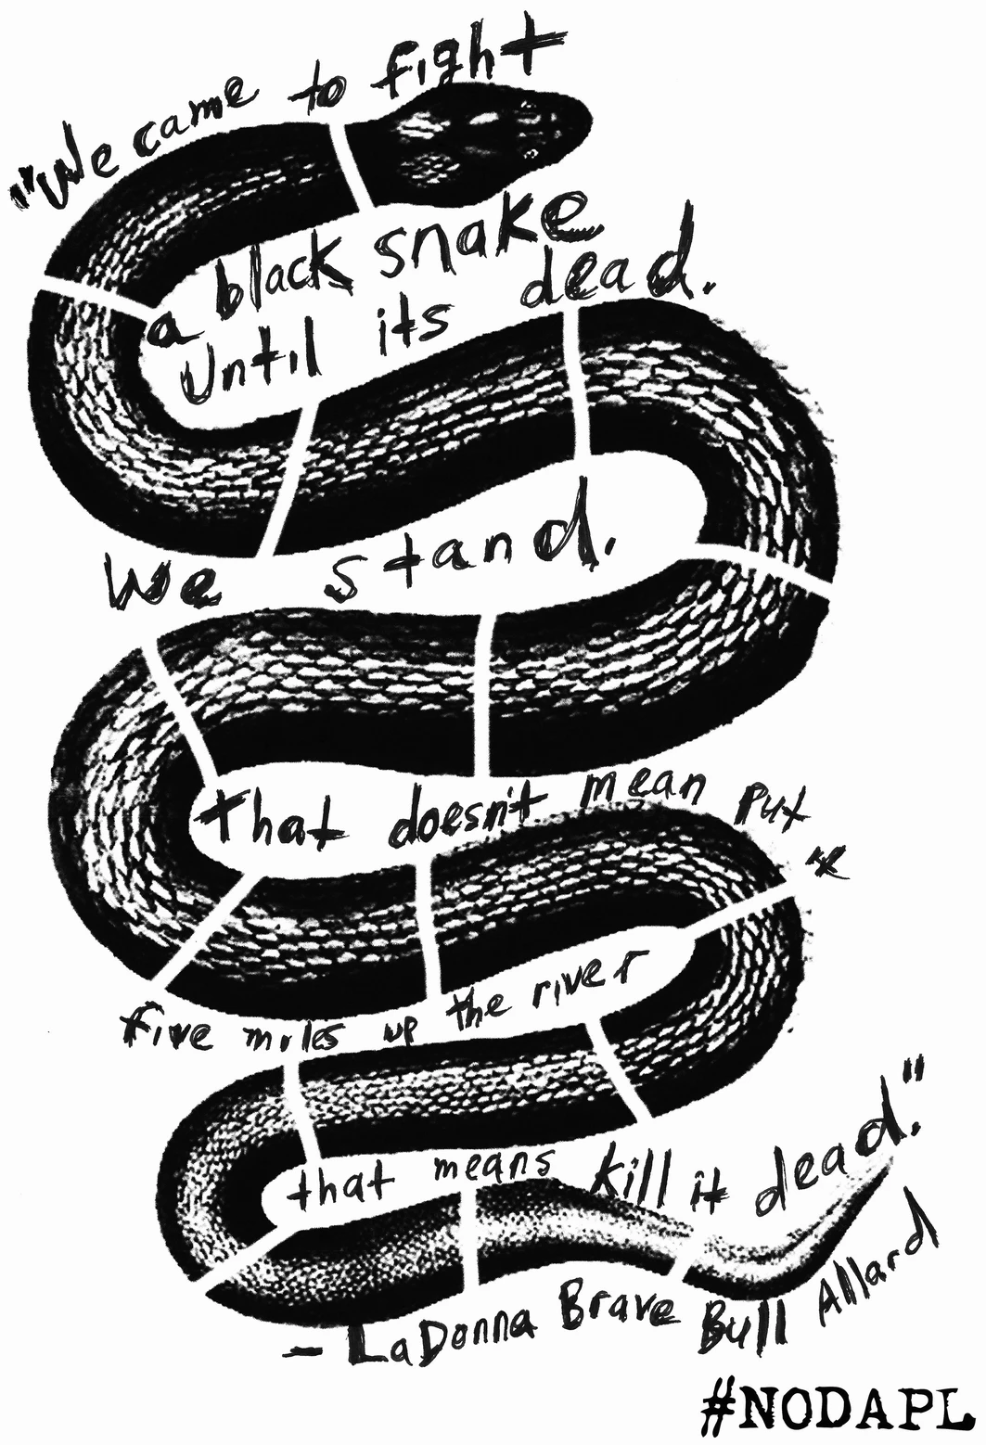
Colonial history
1851 Fort Laramie Treaty: 134m acres, $50,000
Gold and railroads → displacement
1868 Fort Laramie Treaty: 25m acres
Gold discovered in Black Hills
Agreement of 1877 illegally seizes Black Hills
United States v. Sioux Nation of Indians (1980) offered compensation, no land back
Notes:
Vulnerable to environmental contamination due togreater consumption of wild foods (especially fish), and traditional practices
Many displaced
Skirmishes, crazy horse murdered in prison
Never accepted

Slide 7
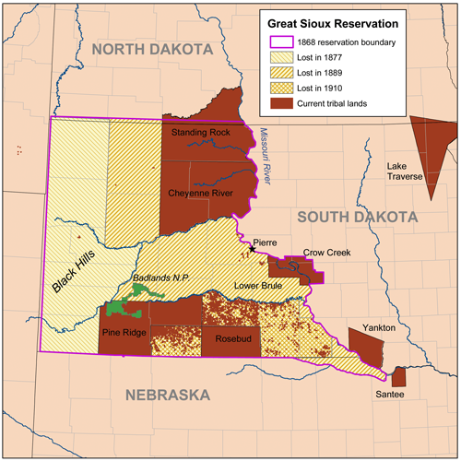
Dispossession & extraction
Massacre at Wounded Knee (1990)
Congress appropriates millions of acres (1889, 1910) overriding treaty rights
Bison decline and dust bow
Flooding of Oahe Dam by Corps evicts 190 families
Now 400,000 acres on which there are 500 oil wells

Slide 8
Principle actors
Energy transfer partners
US Army Corps of engineers (corps)
Standing rock Sioux tribe (srst)
Litigators fabricated existence of sacred sites
No violation of treaty rights
Racketeering claims
Local job creation
Property taxes
Safer than other methods
Energy security
Federal agency responsible for independent evaluation
Prepares Environmental Assessment (EA) as part of National Environmental Policy Act (NEPA)
Follows Council on Environmental Quality (CEQ) guidance
Represented by the non-profit Earthjustice
Points of contention:
  Inadequate consultation
  Infringe on cultural resources (i.e. fishing)
  Infringe on treaty rights
Notes:
Corps responsible because a portion of the DAPL passes through federal projects managed by the USACE, specifically the Garrison Dam on Lake Sakakawea and Oahe Dam on Lake Oahe

Slide 9
Treaty imaginary
Lakota & AIM Occupy Wounded Knee 1973
Rosebud Sioux Tribe – Keystone XL
Congress can abrogate treaty rights—United States v. Kagama (1886) and Lone Wolf v. Hitchcock (1903)
United States v. Sioux Nation of Indians (1980)—compensation, but no treaty breach
Stakeholder > government-to-government (Mitigation Acts of 1998)
CONTRADICTIONS
E.O. 13175 & CEQ → “honor tribal treaty and any other rights”
DOI → “treaties are agreements between two sovereign nations and are, along with the Constitution and Federal laws, the supreme law of the United States”
Notes:
1868 superceded 1851 lands
Political > Legal
Power dynamics of colonization

Slide 10
Levels of legality
Free, Prior, and Informed Consent (FPIC) under United Nations Declaration on the Rights of Ingenious People (UNDRIP)
UN Permanent Forum on Indigenous Issues responds to violent protests in 2016
  Calling on Biden to shut down (TBD)
  Agencies to reform (TBD)
  Codify FPIC H.R. 2689, 2532, S.4331, none passed
  In court, « highly controversial » for other reasons

Slide 11
Permitting process & EJ
NEPA & E.O. 12898 → “hard look” at EJ
FONSI finds no disproportionate harm to minority/low-income community
Court rules ‘cultural, social, economic factors amplify impact on tribes’
Scientific materialism: non-Native scientists
“Culture is not a resource that can be managed”
Categorical Exclusion Determination (CATEX)
Environmental Assessment (EA)
Finding of No Significant Impact (FONSI)
Environmental Impact Statement (EIS)
Notes:
CATEX = no significant impact on human environment
Checklist
Interconnected eco-culture

Slide 12
Tribal consultation and data limitations
Time Commitment
Exhausting
Lack compensation
Lack of trust
Consulting too late
Inadequate resources & training
Corps dismiss tribal concerns in initial 2016 EA
Dakota Access, LLC responds “impossible request to accommodate”
Procedural, already decided upon, about adapting
Data Sovereignty issues → inconsistent, mistrust
5-20% NA unaccounted for in census
Health, pollution, impacts due to climate change
Simple demographic data ≠ cumulative impacts
Interconnected eco-cultures, preexisting generational stressors can not be reduced to statistics

Slide 13
Executive power
e.o. 12898
e.o. 13175
2021 p.m.
2017 p.m.
TBd…
Clinton (1994) EJ for minority & low-income, “differential patterns of subsistence”
Clinton (2000) regular, meaningful, robust consultations and respect sovereignty & treaty rights
Biden reaffirms 2009 P.M. agencies submit implementation plan for E.O. 13175 to OMB to help enforce
Trump advance permitting, allow construction and operation, override EIS at the time
CEQ currently reviving 2020 removal of indirect & cumulative impact mandates. & Biden can shut it down!

Slide 14
Court opinion
March 2020: “highly controversial” to trigger EIS due to opposition from agencies and experts, not tribes
  Leak-detection system with 80% fail rate
  Poor safety record of DAPL operator Sunoco/ETP
  Ice interfering with oil recovery in the event of a winter spill
  Mainly, underestimated Worst Case Discharge (WCD) impacts
Court dismissed non-NEPA-based claims by tribes to address hunting/fishing and EJ effects
Ruled operations should halt in March 2020, D.C. Circuit Court of Appeals reversed injunction based on Monsanto Co. v. Geertson Seed Farms (2010)
Notes:
Monsanto based on 4-factor test for injunctive relief
STILL OPERATING while pending EIS which can take VERY LONG

Slide 15
conclusions
Tribal sovereignty shaped by history of treaty rights violations, extractivism, and land dispossession
International law and extralegal measures may influence legislative and executive action
NEPA & NHPA reviews fail to account for eco-cultural interconnectedness and vulnerabilities
Flawed tribal consultations and data limitations
Executive power influenced EJ approach and permitting decisions, fickle
Courts follow NEPA guidelines

Slide 16
References
American Civil Liberties Union. (n.d.). Stand with standing rock. aclu.org. Retrieved May 10, 2022, from https://www.aclu.org/issues/free-speech/rights-protesters/stand-standing-rock
Aisch, G., & Lai, K. K. (2016, November 23). The conflicts along 1,172 miles of the Dakota Access Pipeline. The New York Times. Retrieved October 11, 2022, from https://www.nytimes.com/interactive/2016/11/23/us/dakota-access-pipeline-protest-map.html
Atencio, M., James-Tohe, H., Sage, S., Tsosie, D. J., Beasley, A., Grant, S., & Seamster, T. (2021). Federal statutes and Environmental Justice in the Navajo Nation: The case of fracking in the Greater Chaco Region. American Journal of Public Health, 112(1), 116–123. https://doi.org/10.2105/ajph.2021.306562
Biolsi, T. (2021). The Treaty Imaginary and Tribal Sovereignty in South Dakota. The American Indian Quarterly 45(3), 209-249. doi:10.1353/aiq.2021.0019.
Braun, Sebastian Felix (2020) Culture, resource, management, and anthropology: Pipelines and the wakan at the Standing Rock Sioux Reservation, Plains Anthropologist, 65:253, 7-24, https://doi.org/10.1080/00320447.2018.1554550
“CEQ Restores Three Key Community Safeguards during Federal Environmental Reviews.” The White House, 19 April 2022, www.whitehouse.gov/briefing-room/press-briefings/2022/07/08/press-briefing-by-press-secretary-karine-jean-pierre-4/. Press release.
Coleman, CL. (2020). How Sioux-Settler Relations Underscore the Dakota Access Pipeline. In: Environmental Clashes on Native American Land. Palgrave Studies in Media and Environmental Communication. Palgrave Pivot, Cham. https://doi.org/10.1007/978-3-030-34106-0_7
Congressional Research Service. (2021, February 1). Court Rules Dakota Access Pipeline Needs Further Environmental Review. Retrieved September 8, 2022, from https://crsreports.congress.gov/product/pdf/LSB/LSB10457
Congressional Research Service. (2021, February 18). Tribal Consultation: Administration Guidance and Policy Consideration. Retrieved September 22, 2022, from https://crsreports.congress.gov/product/pdf/IN/IN11606
Dakota Access, LLC, & United States Army Corps of Engineers Omaha District. (2016). Environmental assessment: Dakota Access Pipeline Project, crossings of flowage easements and federal lands. Retrieved September 8, 2022, from https://usace.contentdm.oclc.org/digital/collection/p16021coll7/id/2427/
Dakota Access Pipeline Facts. Home. (n.d.). Retrieved September 9, 2022, from https://daplpipelinefacts.com/
Dongoske, K. E., Pasqual, T., & King, T. F. (2015). Environmental reviews and case studies: The National Environmental Policy Act (NEPA) and the silencing of Native American worldviews. Environmental Practice, 17(1), 36–45. https://doi.org/10.1017/s1466046614000490
Environmental Protection Agency. (2021, December 15). National Environmental Policy Act Review Process. EPA. Retrieved September 8, 2022, from https://www.epa.gov/nepa/national-environmental-policy-act-review-process
Exec. Order No. 13175, 65 Fed. Reg. 67249 (November 9, 2000) https://www.govinfo.gov/content/pkg/FR-2000-11-09/pdf/00-29003.pdf
FAQ: Standing Rock Litigation. Earthjustice. (n.d.). Retrieved May 10, 2022, from https://earthjustice.org/features/faq-standing-rock-litigation
Harper, B. & Harris, S. (2011). Tribal Environmental Justice: Vulnerability, trusteeship, and equity under NEPA. Environmental Justice, 4(4), 193–197. https://doi.org/10.1089/env.2010.0037
Lewis, J., Hoover, J. & MacKenzie, D. Mining and Environmental Health Disparities in Native American Communities. Curr Envir Health Rpt 4, 130–141 (2017) https://doi.org/10.1007/s40572-017-0140-5
Rainie, S. C., Schultz, J. L., Briggs, E., Riggs, P., & Palmanteer-Holder, N. L. (2017). Data as a strategic resource: Self-determination, governance, and the Data Challenge for Indigenous nations in the United States. International Indigenous Policy Journal, 8(2). https://doi.org/10.18584/iipj.2017.8.2.1
Standing Rock Sioux Tribe & Cheyenne River Sioux Tribe v. U.S. Army Corps of Engineers & Dakota Access, LLC, (U.S. District Court for the District of Columbia, 2016). https://earthjustice.org/sites/default/files/press/2016/3154-66-3-Dec-of-William-Scherman-ISO-MSJ.pdf
Standing Rock Sioux Tribe, et. al. v. U.S. Army Corps of Engineers, et. al., (U.S. District Court for the District of Columbia, 2017). https://legacy-assets.eenews.net/open_files/assets/2017/06/15/document_ew_03.pdf
Tuck, E., & Yang, K. W. (2017, January 19). Decolonization is Not a Metaphor. Decolonization: Indigeneity, Education & Society. Retrieved October 11, 2022, from https://jps.library.utoronto.ca/index.php/des
Council on Environmental Quality. (1997). Environmental Justice Guidance Under the National Environmental Policy Act https://www.epa.gov/sites/default/files/2015-02/documents/ej_guidance_nepa_ceq1297.pdf
U.S. Department of the Interior, U.S. Department of the Army, U.S. Department of Justice. (2017). Improving Tribal Consultation and Tribal Involvement in Federal Infrastructure Decisions https://www.bia.gov/sites/default/files/dup/assets/as-ia/pdf/idc2-060030.pdf
Young, Stephen. (2017). The Sioux's Suits: Global Law and the Dakota Access Pipeline," American Indian Law Journal: Vol. 6 : Iss. 1 , Article 4. https://digitalcommons.law.seattleu.edu/ailj/vol6/iss1/4

